Slide 1
Data Admin Concepts and Database Management
Final Project 2022/12/18
Tim Tieng, Peter Broecker, Gustavo Gyotoku

Slide 2
Table of Content
Conceptual ER Model
ERD Model
SQL Script – Up/Down
SQL Script – Create Tables
SQL Script – Insert Tables
SQL Script – Test Script
Team Project Progress Board
APPENDIX

Slide 3
Introduction / Solution
Our company provides millions of songs from various artists available for streaming. We offer over a million songs available to stream and even have playlists organized by genre with endless hours of podcasts and audiobooks from a variety of genres. Given the sheer size of data, it is necessary to have a strong database system. This means that queries should be efficient and reliable.
Since the data in our 17 year old database has outgrown our system to support it, we need to work on a new iteration of the RDBMS. In the next couple of months, we will meet with key stakeholders and capture all business requirements.

Slide 4
Data Analysis
Users should be able to “like” a song.
Users should be able to see different categories of genres.
Under these categories, users should be able to see song selections.
Users should be able to query a song by artist name, song name, or album.

Slide 5
Data Analysis
Users should be able to save and access a playlist.
Users should have access to:
playlist
podcast
Albums
Users should be able to filter items by:
recently played
recently added
alphabetical

Slide 6
Data Analysis (Cont.)
Users should be able to save their music settings. These include:
Language
Explicit content
Autoplay
Audio quality
Volume Level

Slide 7
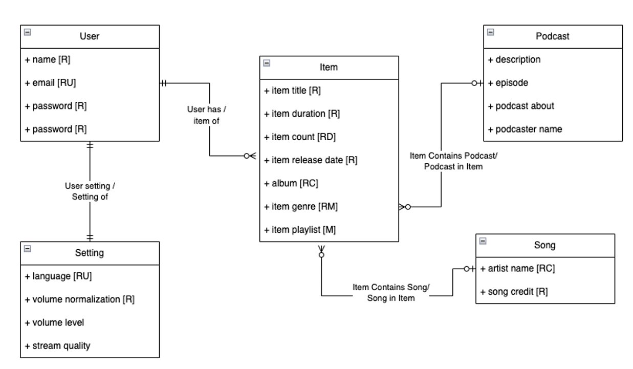
Conceptual ER Model
Based on Business Requirements:

Slide 8
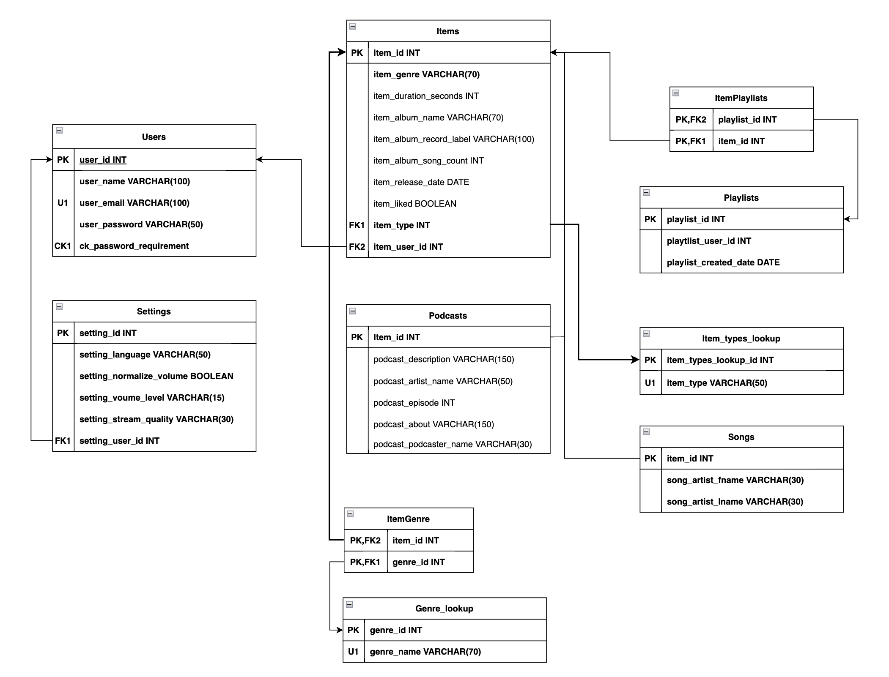
ERD Model
Logical Model:

Slide 9
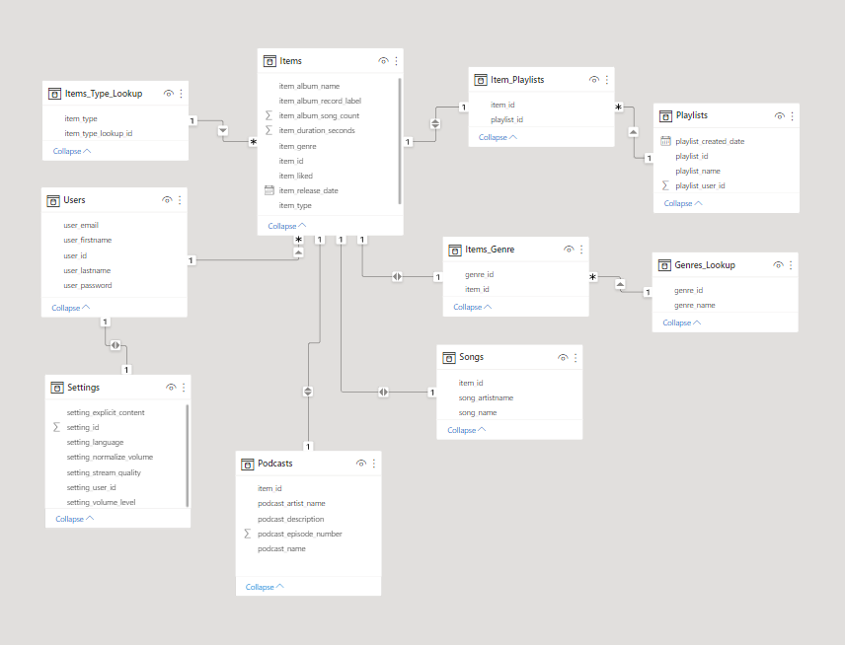
ERD Model
Logical Model:

Slide 10
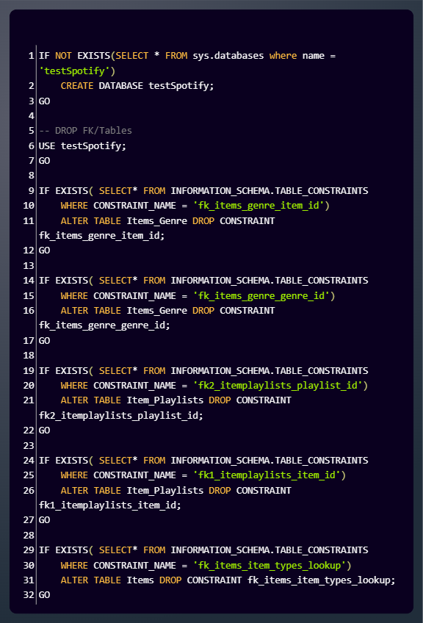
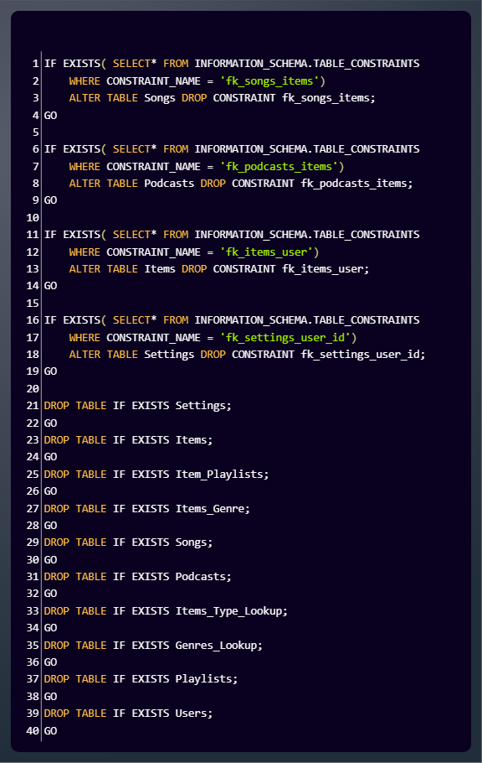
SQL Script - Up/Downs Script

Slide 11
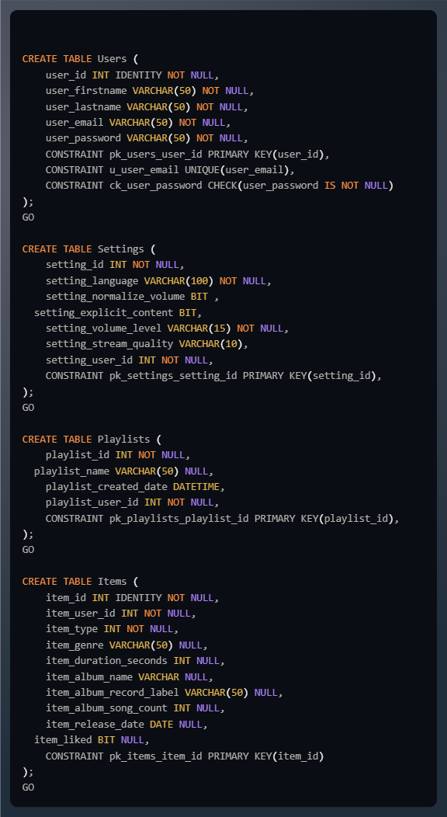
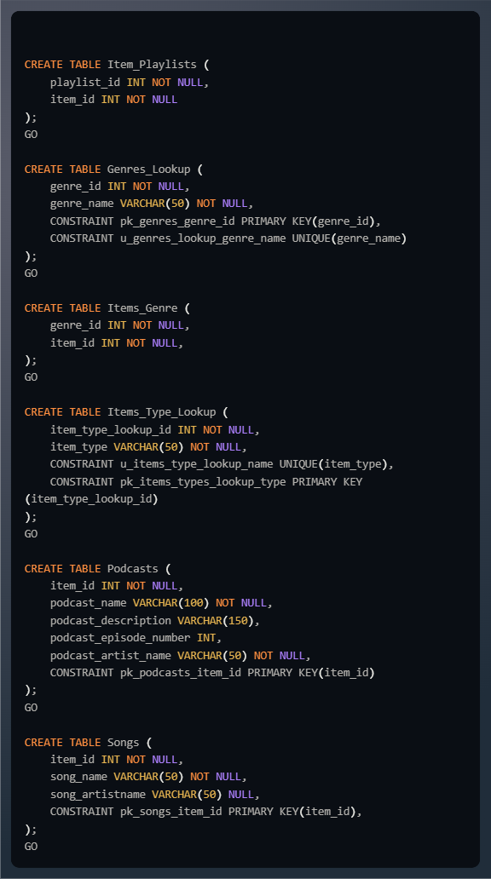
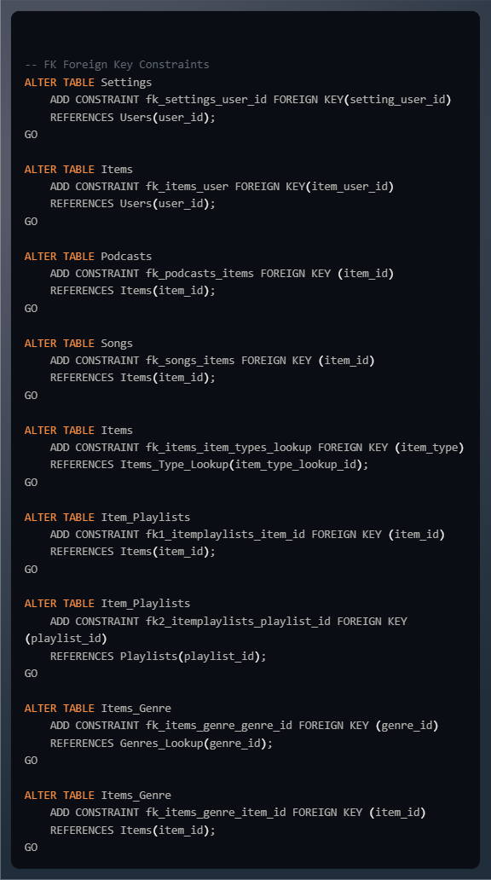
SQL Script – Create/Alter Tables

Slide 12
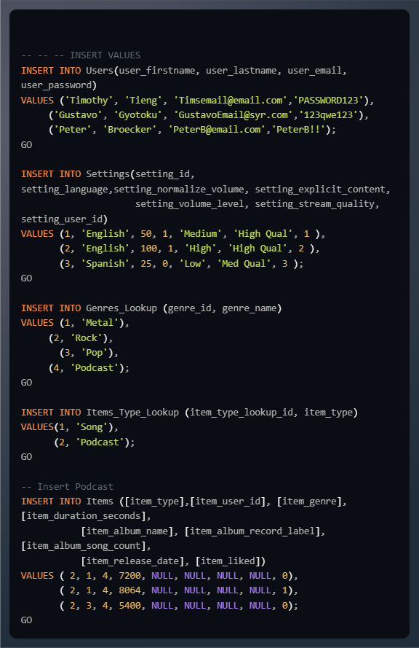
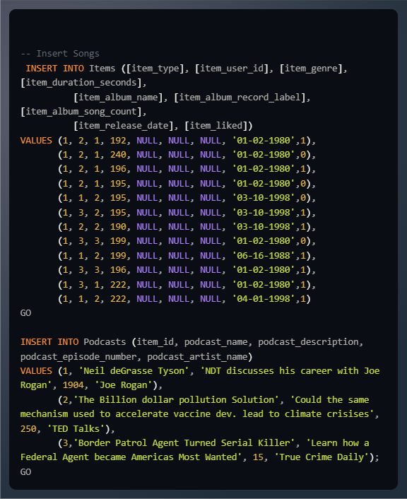
SQL Script – Insert Values

Slide 13
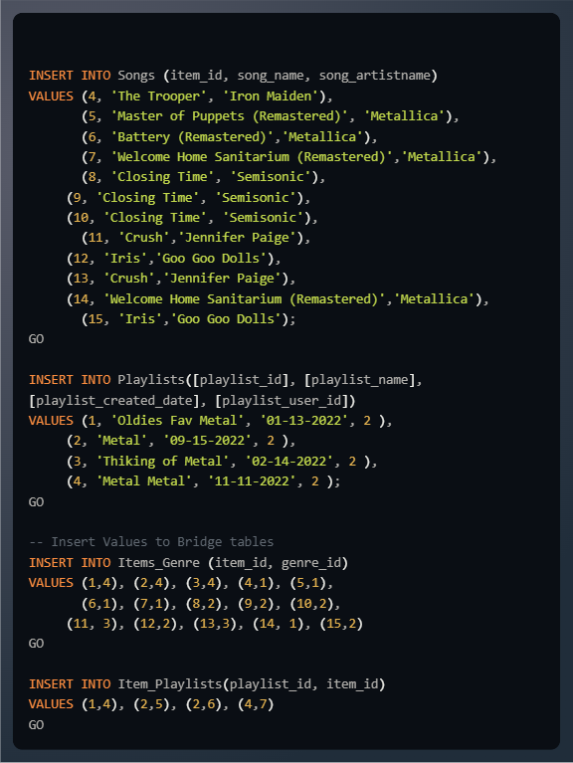
SQL Script – Insert Values (Continue)Script

Slide 14
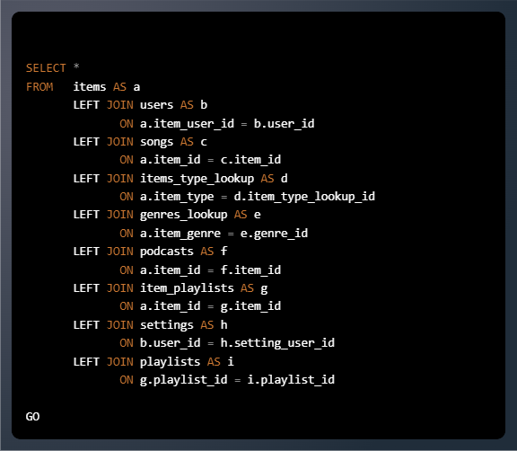
SQL Script – Test Script

Slide 15
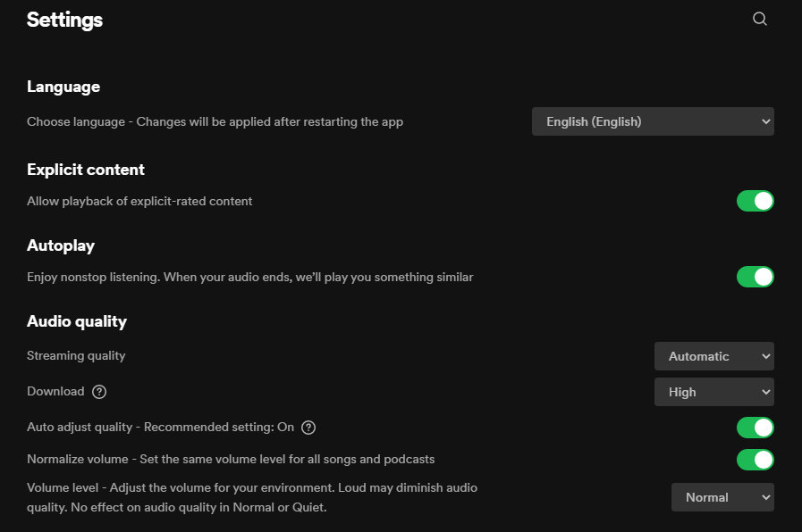
Application
The user settings are stored within the “Settings” table.

Slide 16
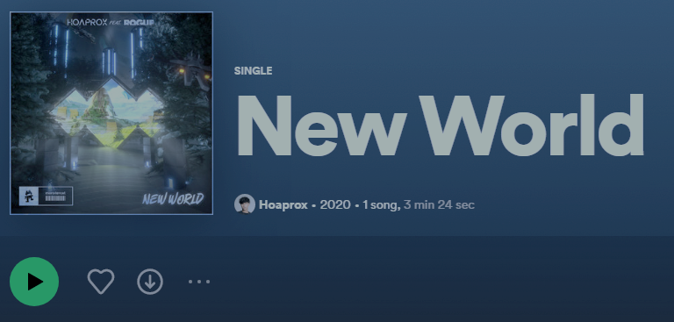
Application (Continue)
When the User clicks on the heart, then he or she has liked a song. The RDMS saves that as a BIT. One for “liked”, and 0 for “not liked”.

Slide 17
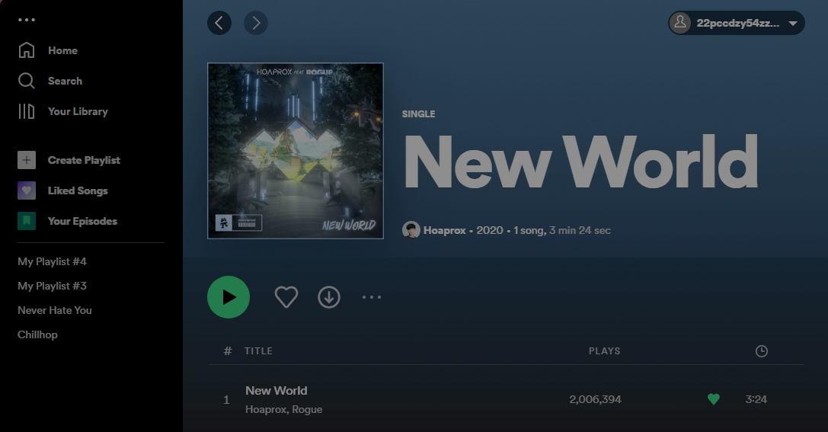
Application (Continue)
When the user creates a playlist, it is stored in the “Playlists” table.

Slide 18
Application (Continue)
When the user creates a playlist, it is stored in the “Playlists” table.

Slide 19
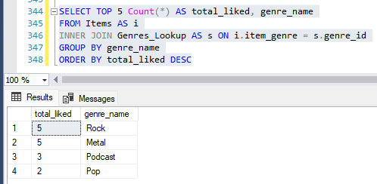
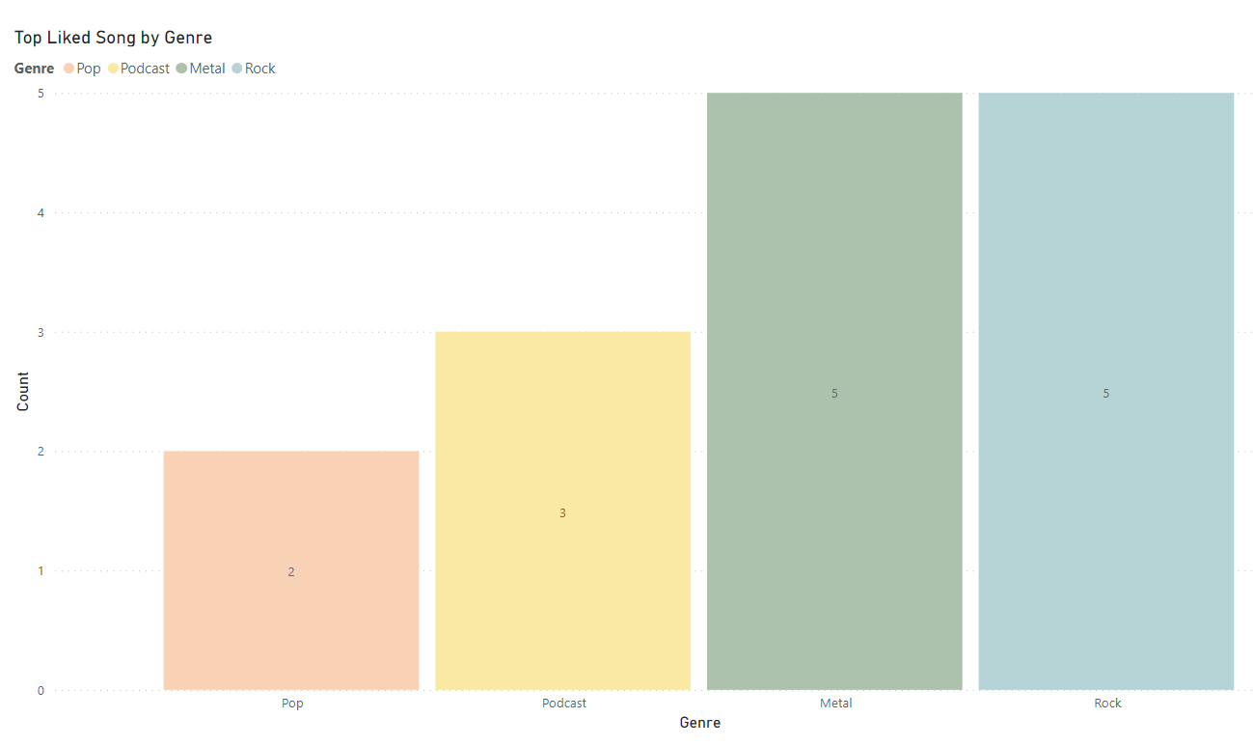
Business Questions
Questions to better understand the user base, these queries could help improve recommendations based on user habits and user preferences. Good recommendations of songs, artists, and podcasts can increase user engagement and provide a better experience.
What are the most liked songs based genre?

Slide 20
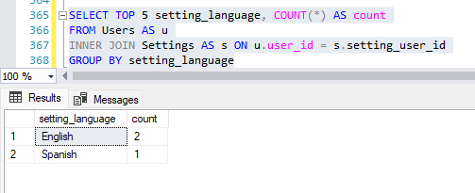
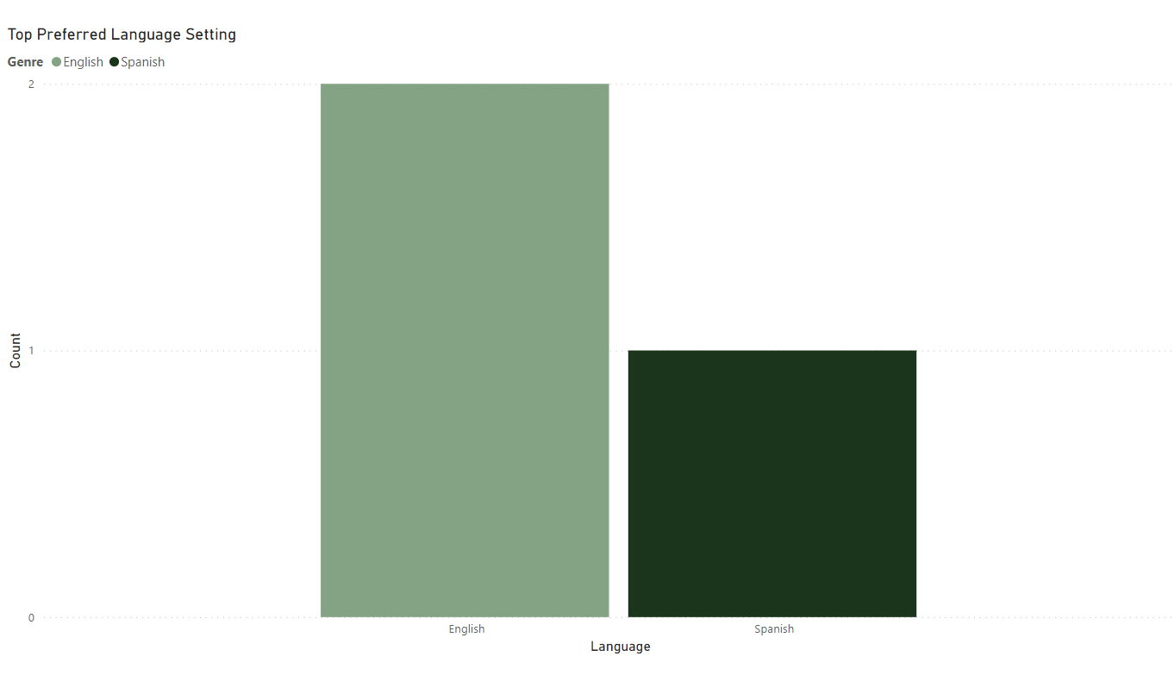
Business Questions
Questions to better understand the user base, these queries could help improve recommendations based on user habits and user preferences.
What is the language preference for each user?

Slide 21
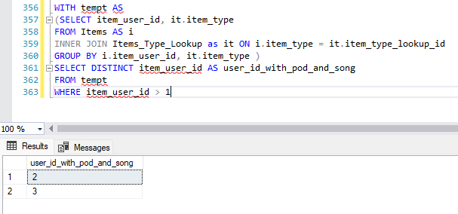
Business Questions
Questions to better understand the user base, these queries could help improve recommendations based on user habits and user preferences.
What users listen to both music and podcasts?

Slide 22
Team Project Progress Board
Task | Task Name | Status | Completed By | Additional Notes
1 | Document with team name, group members, and which project you will work on. If the project is your own idea, a requirements document must be submitted and approved. | Complete | Tim Tieng, Peter Broecker, Gustavo Gyotoku | This task was completed as a group through team conversations and brainstorming sessions
2 | Data analysis of the facts listing entities, attributes, and relationships in the data model. | Complete | Tim Tieng, Peter Broecker, Gustavo Gyotoku | This task was completed as a group through team conversations and brainstorming sessions
3 | Conceptual data model diagram. | Complete | Tim Tieng, Peter Broecker, Gustavo Gyotoku | This task was completed through collaborative sessions and feedback loops
4 | Logical data model diagram. | Complete | Tim Tieng, Peter Broecker, Gustavo Gyotoku | This task was completed through collaborative sessions and feedback loops
5 | Identification of your external data model and data logic. | Complete | Tim Tieng, Peter Broecker, Gustavo Gyotoku
6 | Basic layout of all application screens. | Complete | Peter Broecker, Gustavo Gyotoku
7 | Diagram of each screen used in the application. | Complete | Tim Tieng, Peter Broecker, Gustavo Gyotoku
8 | SQL up/down script to implement the internal model with initial data. | Complete | Tim Tieng, Peter Broecker, Gustavo Gyotoku
9 | SQL up/down Script to load/migrate in existing data. | Complete | Tim Tieng, Peter Broecker, Gustavo Gyotoku
10 | SQL up/down script of data logic for the external data model. | Complete | Tim Tieng, Peter Broecker,
11 | Implementation of the application itself. | Complete | Tim Tieng, Peter Broecker,
12 | A team log recording individual and group contributions to the project, including when and by whom. | Complete | Tim Tieng

Slide 23
Appendix

Slide 24
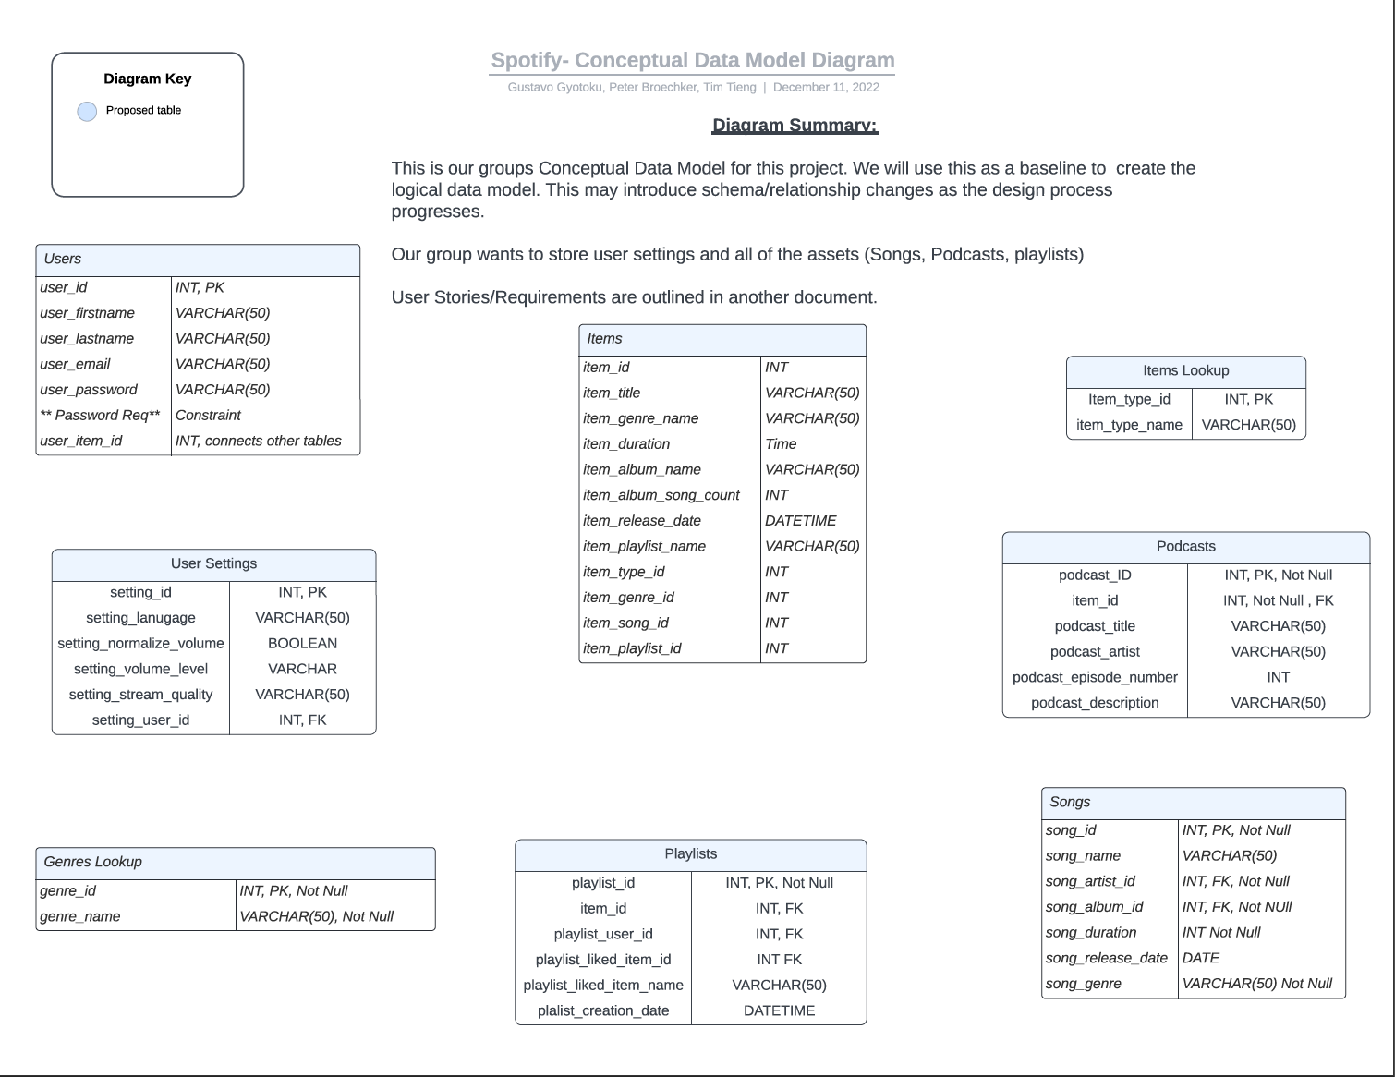
Additional Diagrams

Slide 25
Thank You!
Final Project 2022/12/18
Tim Tieng, Peter Broecker, Gustavo Gyotoku

